Slide 1
Day 38 September 30
What did The Treaty of Versailles do?
What do the letters in BRAT stand for?
How do you think the treaty will effect Germany’s economy?
HW: Finish quote sheet if not finished in class.

Slide 2
Day 39 October 1
What three things helped Hitler rise to power?
Why did most Germans believe in Hitler?
What was Hitler’s plans for Germany?
HW: Complete map of Europe.

Slide 3
Day 40 October 2
What was the Holocaust?
What was one of the most known concentration camps during WWII?
Who freed the prisoners of the camps at the end of the war?
HW: Have a good weekend!

Slide 4
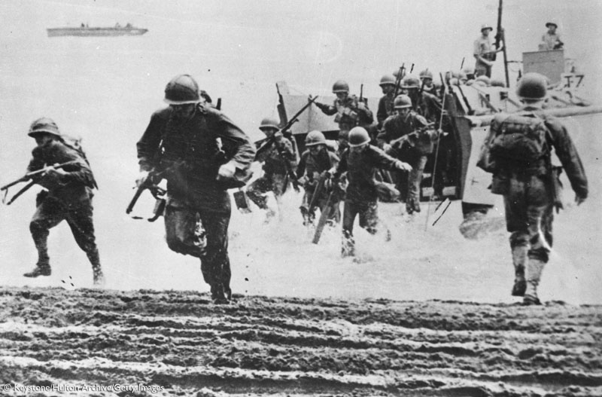
WORLD WAR II
PAGES 540-547

Slide 5
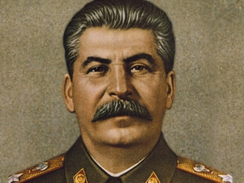
Review: Who was the powerful totalitarian leader of Russia after its revolution?
What does “totalitarian” mean?
What was life like under this leader’s rule?

Slide 6
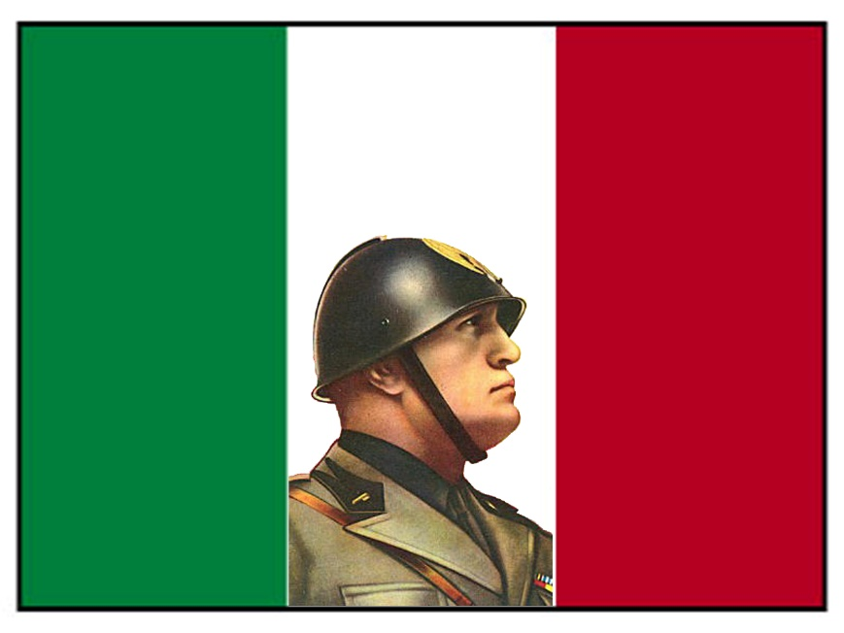
Fascism
A type of government: the goals of the government are thought to be more important than those of individual people
In some places, fascism also came to mean hatred of certain ethnic groups

Slide 7
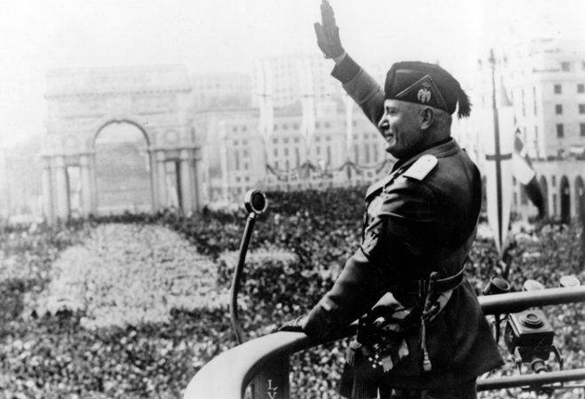
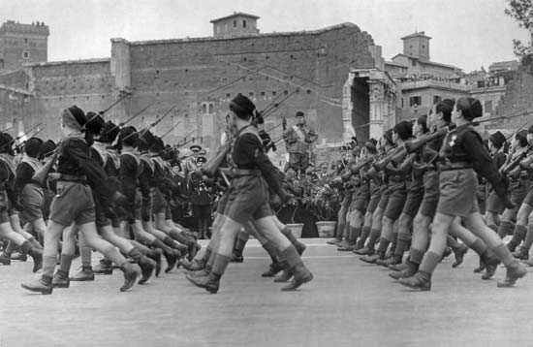
What beliefs are key to fascism?
A powerful leader
Totalitarian government
Extreme nationalism

Slide 8
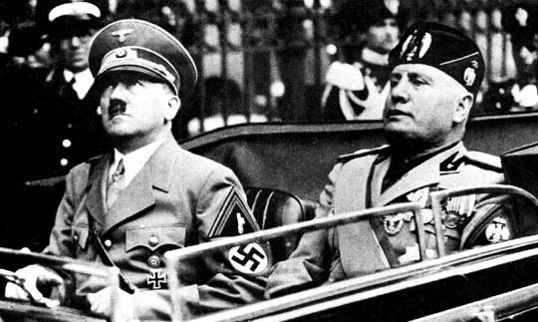
Mussolini and Hitler join forces
Another fascist dictator was Adolf Hitler of Germany
After Mussolini took control of Ethiopia in 1936, the two dictators joined forces

Slide 9
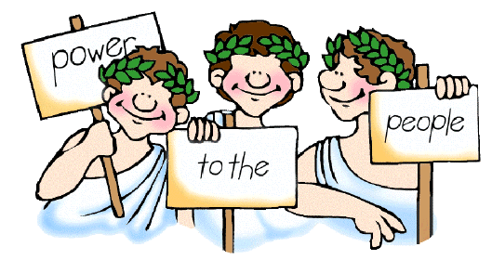
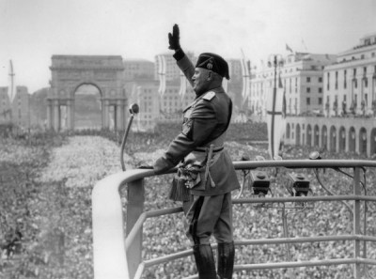
How would you contrast fascism and democracy?
Fascism: people serve government
Democracy: government serves people
Fascism
Democracy

Slide 10
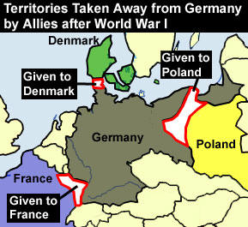
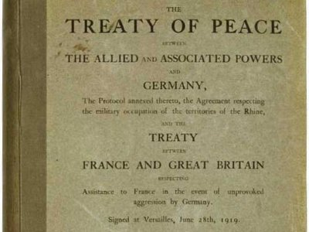
Germany After WWI
Germany was forced to live by the Treaty of Versailles
The treaty stripped Germany of land and forced it to pay huge fines
How do you think Germany paid off these expenses?

Slide 11
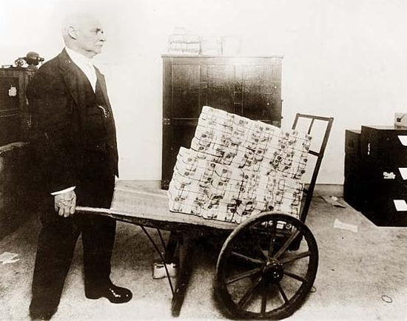
Inflation
Germany began printing large amounts of paper money
Germany’s money lost its value
The result was inflation (rising prices)
By 1923, Germany money was practically worthless, and people’s savings were gone

Slide 12
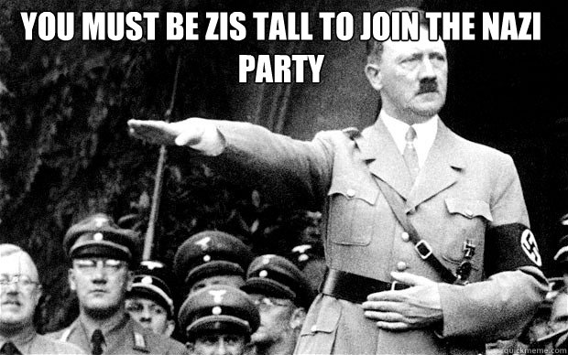
The bitter ex-soldier Adolf Hitler
1923: led an attack against the German government
The attack failed, and Hitler was jailed – however, many Germans supported his actions
Hitler’s followers were known as the Nazi party

Slide 13
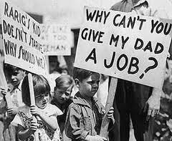
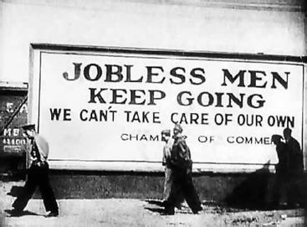
Depression
By 1930s, Germany and much of the rest of the world suffered a depression
What is a depression?
Fewer goods are produced, prices drop, many people lose their jobs, money is hard to get
What was America’s depression like in the 1930s? How do we refer to this time period today?

Slide 14
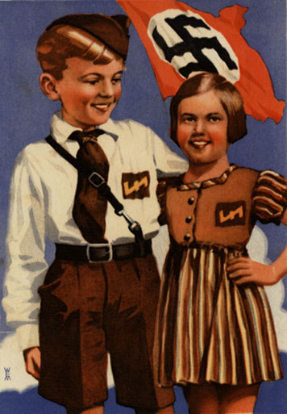
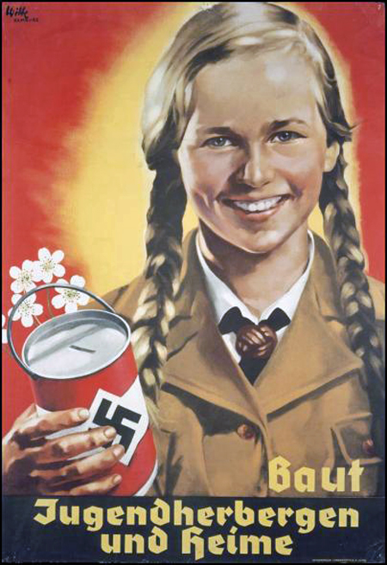
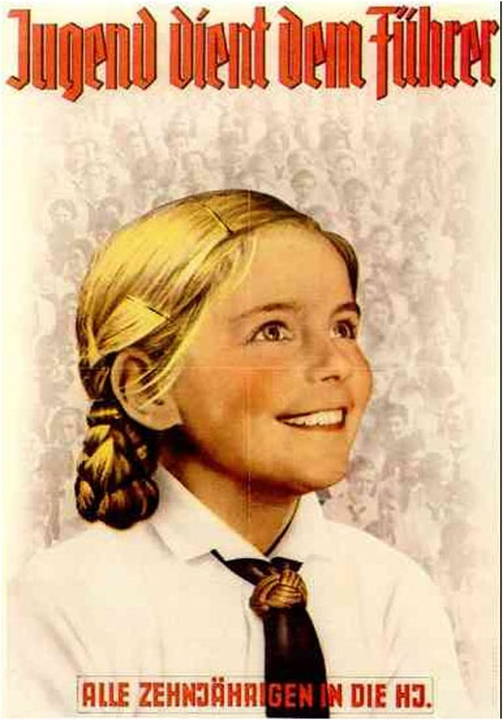
Hitler’s Propaganda
During hard times, Hitler used propaganda to convince Germans that their nation could once again become powerful
What is propaganda?
The spreading of certain ideas or attitudes that have been exaggerated or falsified to advance a particular cause

Slide 15
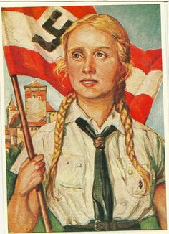
Hitler’s Propaganda
Spread the false idea that the Germans were a “master race” meant to rule the world
The Nazis wrongfully blamed Germany’s Jews, along with the Treaty of Versailles, for the depression
Promising to raise Germany back to glory, Hitler gained control in 1933

Slide 16
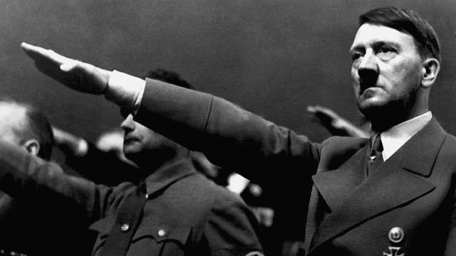
The Fascist dictator, Adolf Hitler
Formed an alliance with Mussolini in Italy
He and the Nazis stirred up hatred against Jews

Slide 17
How did Hitler use propaganda to gain power?
He used exaggerations and lies to tell Germans they were blameless in their fate, that Jews and the Treaty of Versailles were to blame, that Germans were a master race who should rule the world

Slide 18
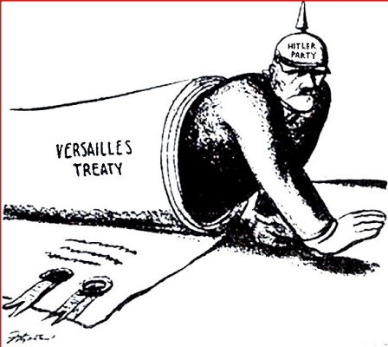
Hitler violates the Treaty of Versailles
1938: ordered Nazi troops to occupy Austria
He knowingly broke the rules of the Treaty
1939: Hitler gained control of Czechoslovakia
Britain and France promised to defend Hitler’s next target, Poland
What is going to happen when Britain and France stand their ground?

Slide 19
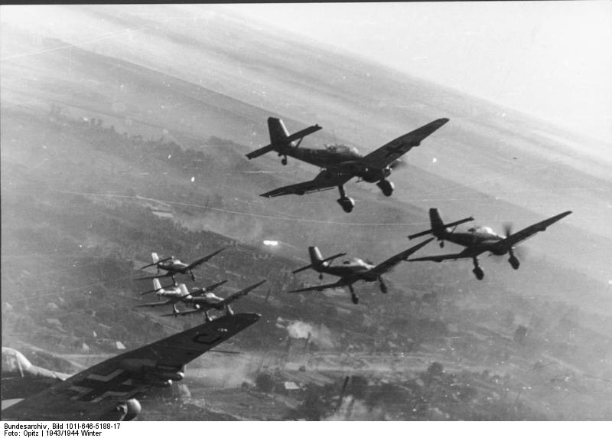
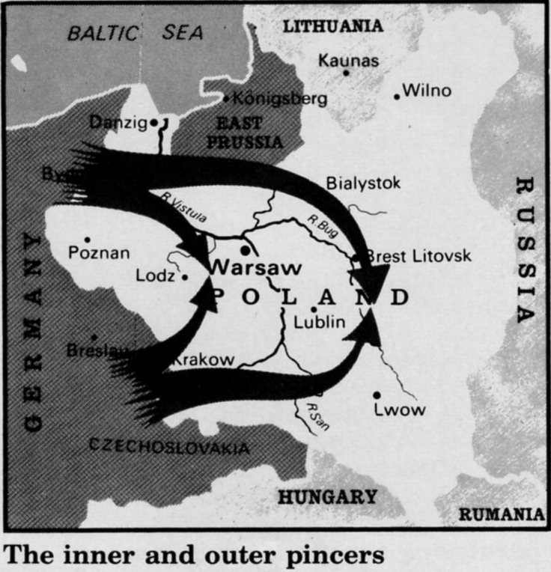
WWII Begins: September 1, 1939
German tanks began a “blitzkrieg” – a “lightning war” in Poland
Hitler and Stalin had a friendship treaty
With the help of the Soviet Union, Germany defeated Poland within weeks

Slide 20
How did Britain and France respond to the attack on Poland?
By declaring war on Germany

Slide 21
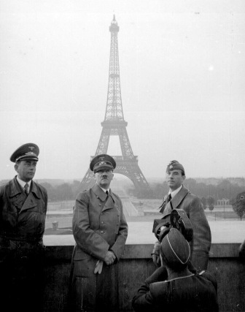
Hitler’s fighting method of blitzkrieg
Proved to be very effective
Seized Paris – Germany had beaten France (a major world power) in only six weeks!
Hitler made Britain the next Nazi target

Slide 22
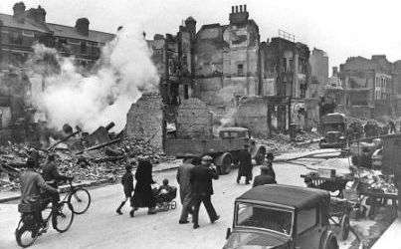
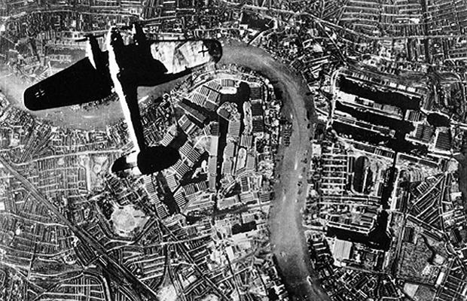
The Battle of Britain
British people prepared for the worst
Prime Minister, Winston Churchill, stated “..we shall never surrender..”
August 1940: Battle began
For almost a year, German planes bombed Britain every night
More than 12,000 British people died
Despite the cost, Britain did not surrender – the nation stood firm

Slide 23
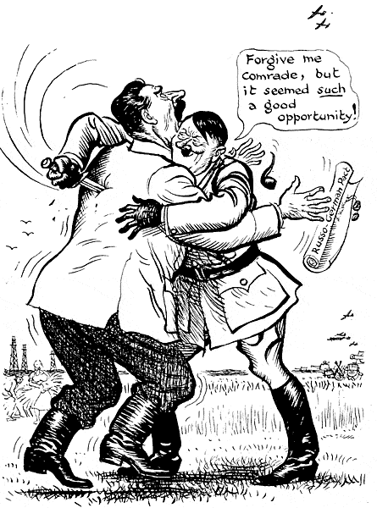
The Soviet Union
June 1941: Hitler ended the bombing of Britain
Germany lost more than 2,000 planes
Having failed Britain, Hitler broke off his Treaty with Stalin
Ordered troops to invade the Soviet Union
Germans fought for three years to control major Soviet cities and supply centers
Millions of Soviet soldiers and civilians died in the struggle

Slide 24
Why do you suppose Hitler broke his pact with Stalin?
Perhaps Hitler thought the Soviet Union was an easier target than Britain
Hitler had always intended to invade the Soviet Union to gain additional “living room”
He believe the growing German population needed this room

Slide 25
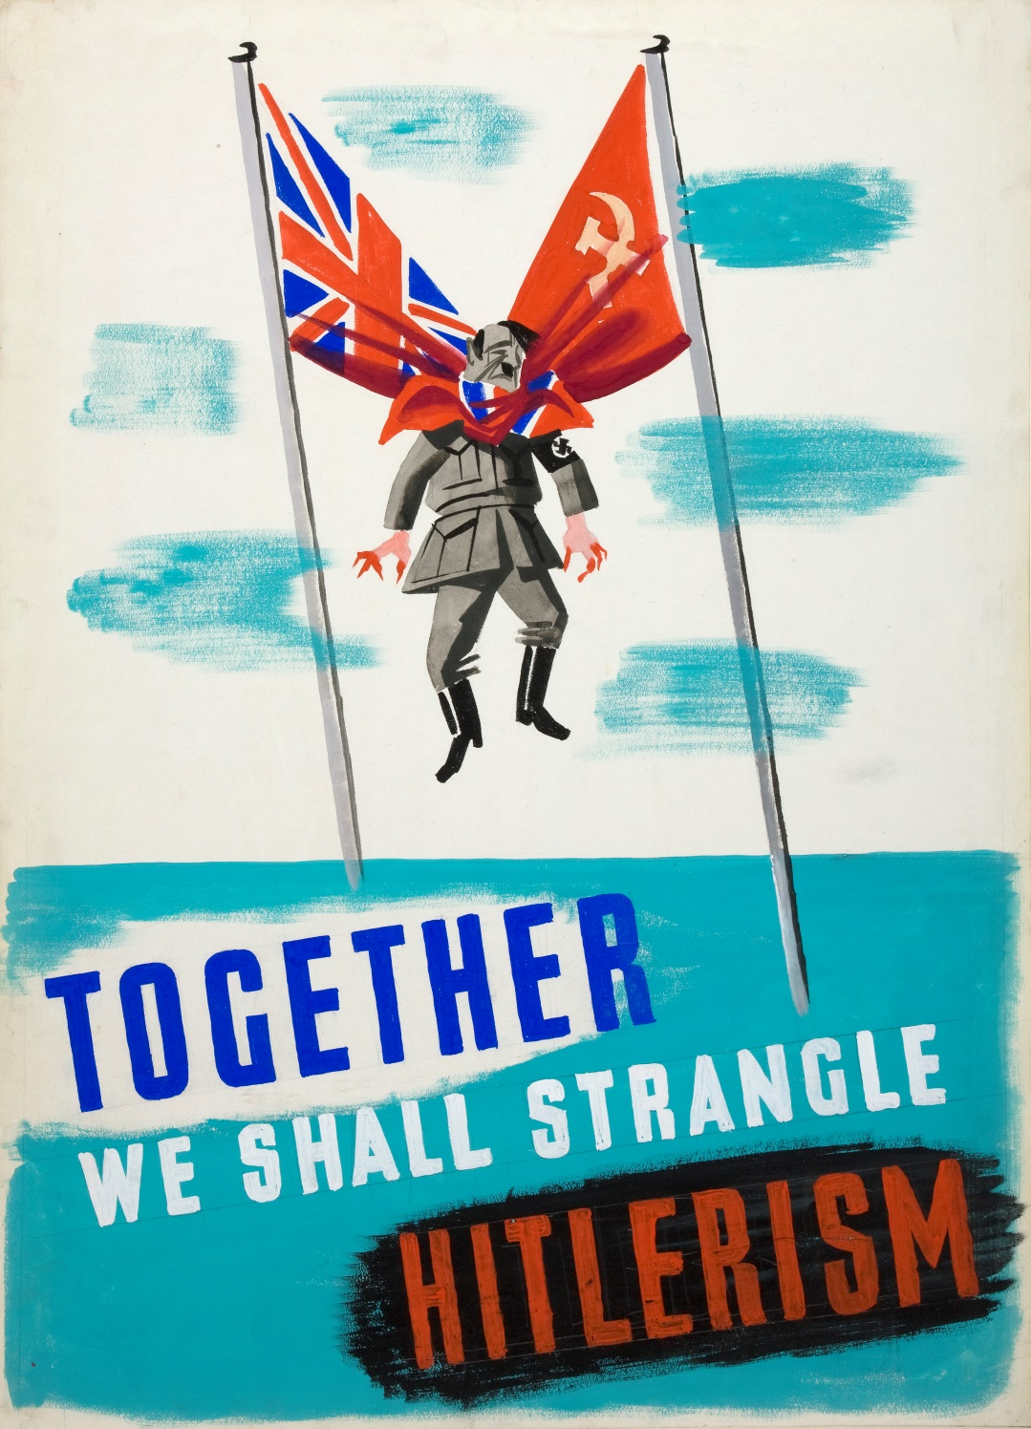
Soviet Union & Britain = Allies
Great Britain and the Soviet Union had many differences, but both now had a common enemy

Slide 26
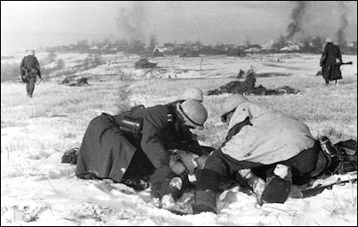
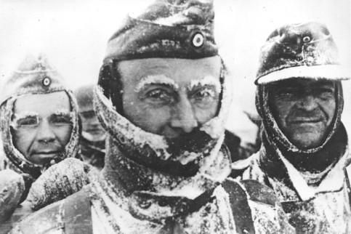
Weather Plays a Part
Germany troops were near to one of their goals: the Soviet capital (Moscow)
HOWEVER, the troops were stopped by a deadly northern winter
December 6, 1941: near frozen Germans began to retreat

Slide 27
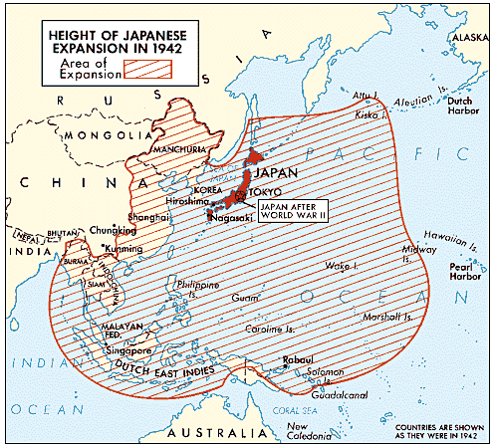
Japan
War erupted in Asia before it did in Europe with Hitler
Japan had hoped to create an empire with an endless supply of raw materials for industry
1931: Japanese forces invaded Northern China – Japan conquered ¼ of China
1940: Japan formed an alliance with Germany

Slide 28
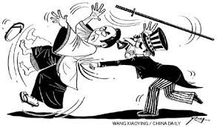
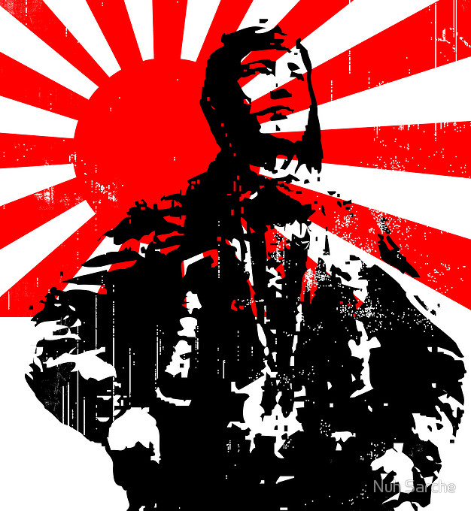
The United States and Japan
The U.S. was AGAINST the Japanese expansionist policy
Japan was determined to stop the United States from hurting their expansionist plans

Slide 29
What do you think Japan did to stop the U.S. from interfering in its expansionist plans?

Slide 30
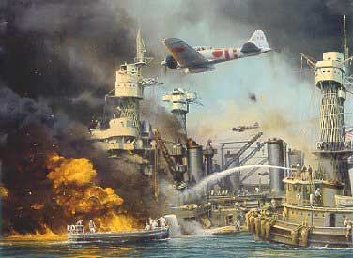
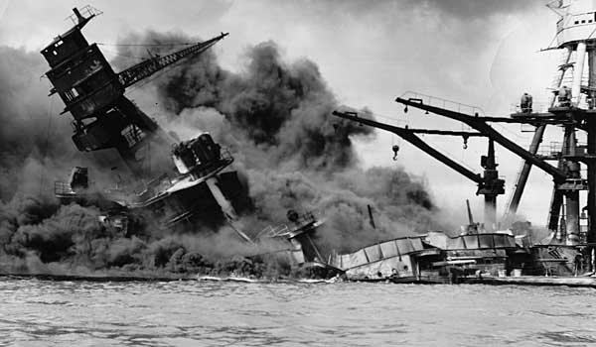
Pearl Harbor
December 7, 1941: Japan launched an attack without any warning or declaration of war
The target was the U.S. naval base at Pearl Harbor, Hawaii
More than 2,000 people died in the attack
The U.S. was now involved in the war

Slide 31
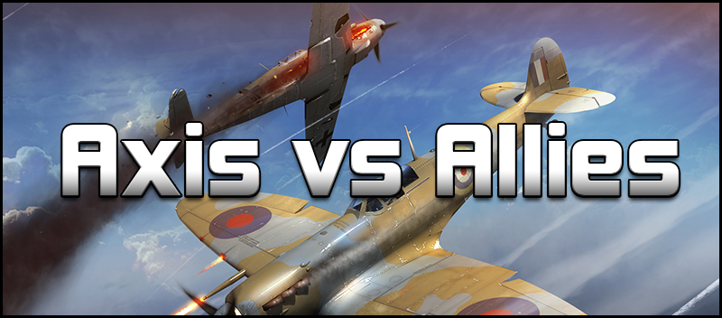
United States Declares War
President Franklin Roosevelt declared war on Japan December 8, 1941
Germany and Italy declared war on the U.S. three days later
Japan, Germany, Italy were known as the AXIS POWERS
Britain, France, Soviet Union, China, and U.S. were known as the ALLIES

Slide 32
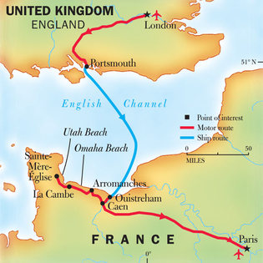
“The Longest Day”
June 5, 1944: Allies planned a surprise invasion of Axis-held France
If they succeeded, Germany would be surrounded on three sides (west, east, and south)
Allies’ code for this operation was D-Day
“D” stands for “day,” as in “a red-letter day”

Slide 33
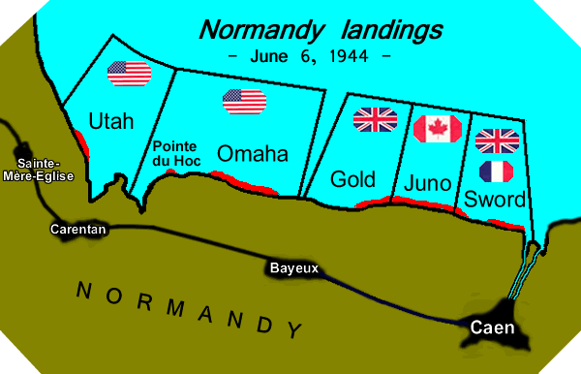
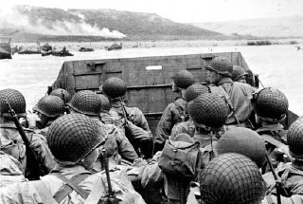
D-Day: June 6, 1944
Allied forces prepared to land on beaches of Normandy, France at dawn
On June 4, there was a huge storm – the storm actually helped the Allies because the Germans believed the Allies would not invade in such weather
German commander traveled home to Germany because of the weather
Over 11,000 Allied planes dropped bombs
Allied forces gained control of the beaches

Slide 34
Why do you suppose D-Day seemed like “the longest day” to those who took part in it?
Troops had to charge up on shore, facing heavy fire and a strongly entrenched and heavily armed enemy

Slide 35
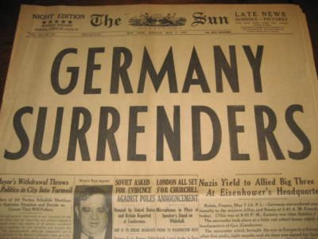
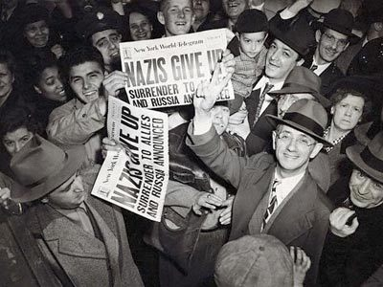
End of the War
Less than a year after D-Day, Allied forces closed in around Germany
Adolf Hitler killed himself to avoid capture on April 30, 1945
One week later, Germany surrendered
Japan, however, refused to give up struggle for power

Slide 36
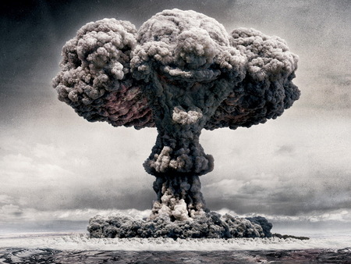
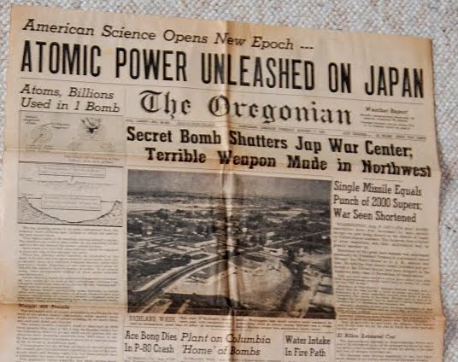
Japan’s Surrender
U.S. leaders determined that invading Japan could lead to many deaths
August 6, 1945: The U.S. dropped the first atomic bomb ever used in warfare on the Japanese city, Hiroshima
At least 80,000 people died
Japan did not surrender
Three days later, the U.S. dropped a second atomic bomb on the city of Nagasaki
Japan surrendered on August 14, 1945

Slide 37
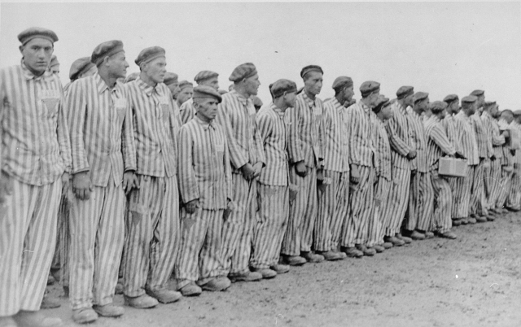
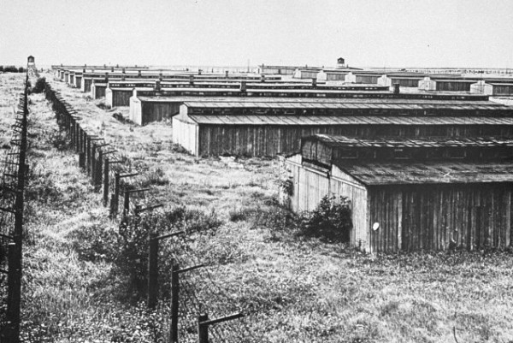
Concentration Camps
What is a concentration camp?
Places where people are imprisoned because of their heritage, religious beliefs, or political views
Prisoners in Nazi concentration camps were tortured and killed

Slide 38
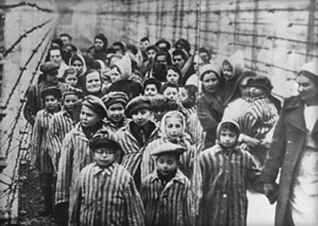
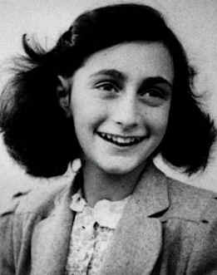
The Holocaust
Nazis murdered about 6 million Jews (in concentration camps or by execution squads)
The people killed had committed no crime; they were killed only because they were Jewish
What is a Holocaust?
The deliberate destruction of human life
Another 6 million people (Gypsies, Poles, Russians, and Slavs) were also murdered in Nazi concentration camps

Slide 39
How can you relate Hitler’s theory of the “master race” to the Holocaust?
Believing oneself to be master of others might lead to the belief that one has the right to exterminate them

Slide 40
Effects of the War
50 million people died in World War II
Millions more would be affected by its horrors throughout their lives
Destroyed roads, bridges, homes, and cities around the world had to be rebuilt
The two most powerful Allies, the U.S. and the Soviet Union, would become bitter enemies

Slide 41
Think About It (Partners)
How did the United States help the Allied war effort?
Why was D-Day an important battle?
How did Hitler use the problems created by inflation, the depression, and unemployment to make himself dictator of Germany? How did he use this power to bring about World War II?
What role did weather play in the planning and outcome of D-Day?

