Slide 1
Government of Latin America
SS6CG1: Government-Compare and Contrast Citizen Participation (Democracy and Autocracy)
a. Autocratic and Democratic (role of citizens in choosing leaders of Mexico, Cuba & Brazil)
b. Two predominant forms of Democratic governments: Parliamentary and Presidential

Slide 2
Citizen Participation
1. Autocratic/Autocracy
Power is held by ONE person- Sometimes inherited, sometimes taken by military force
3 types:
Dictatorship (Hitler)
Constitutional Monarchy (UK)
Absolute Monarchy

Slide 3
Citizen Participation
2. Oligarchic/Oligarchy
Power is held by FEW (family, clan) – Power comes from wealth, social status, or military power
Elections held – only 1 candidate
Ex. Ancient Greece & Rome

Slide 4
Citizen Participation
3. Democratic/Democracy
Power is held by THE PEOPLE – Individual freedom & equality is valued
2 types:
Direct Democracy (Ancient Athens) – People vote on ALL issues
Representative Democracy (Republic, USA) – Representatives elected by people vote

Slide 5
Democratic Governments
1. Parliamentary Democracy
Citizens elect members of parliament (MP’s)
MP’s elect leader among themselves called Prime Minister=chief executive
Chief Ex heads military, enforces laws, and keep country running
Head of state=symbolic leader (king/queen)
Ex. Australia, Canada, UK

Slide 6
Democratic Governments
2. Presidential Democracy
Citizens elect members of legislature
Chief Ex. & head of state=president
President runs gov’t & heads military
Legislature makes laws
Ex. US, Mexico, Most South Am. countries

Slide 7
Latin American Government
1. Federative Republic of Brazil
System = Federal
Power divided between central gov’t & state and local gov’t
Citizen Participation = Presidential Democracy
Right to vote: 18-70=required to vote, optional for 16-17 & 70+
Average level of freedom – personal property rights are not always protected & court system cannot be trusted in all cases

Slide 8
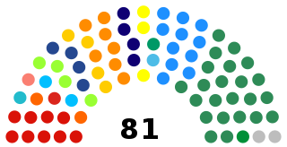
Brazil’s Legislature
The National Congress of Brazil is their Legislature
They have 81 seats

Slide 9
Latin American Government
2. United Mexican States
System = Federal
Power divided between central gov’t & state and local gov’t
Citizen Participation = Presidential Democracy
Right to vote: 18+ may vote
Average level of freedom – court system controlled by central gov’t, not independent of president

Slide 10
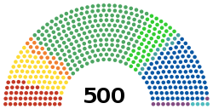
Mexico’s Legislature
Their legislature is bicameral: The Chamber of Deputies and the Senate

Slide 11
Latin American Government
3. Republic of Cuba
System = Unitary
Communist party controls the strong central gov’t & smaller units in country
Citizen Participation = Communist Dictatorship
People vote for National Assembly of People’s Power which appoints president – Communist Party must approve all candidates
Right to vote: 16+ may vote
One of least free countries in world - Gov’t controls nearly all aspects of life (property, businesses, factories, farms)

Slide 12
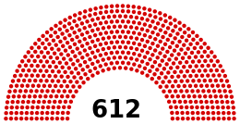
Cuba’s Legislative Branch
The National Assembly of People's Power is the legislative branch for Cuba
They have all the power

