Slide 1
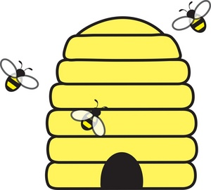
What is Colonization?

Slide 2
What is Colonization?
Think of it like bees…
The bees have their hive and within their hive they have a Queen. The bees belong to the hive. BUT… they will go out of the hive and search for nectar (resources) to take back to the hive.
European Countries like Britain, France, and the Netherlands would go and claim land as their own and take back resources to their own country.

Slide 3
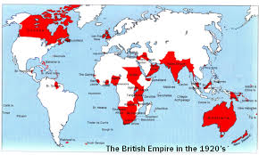
Colonization was important to Europeans because….
The more land a country controls, the more natural resources a country gets.
British Empire

Slide 4
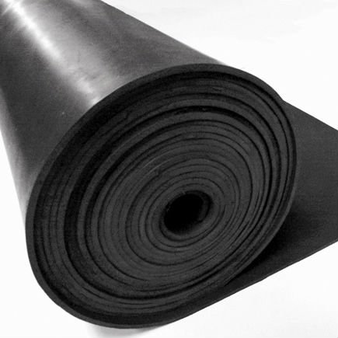
Colonization was important to Europeans because….
2. Having natural resources made nations wealthy.
If you had the majority of rubber in your country you could control the price and make plenty of money. (Monopoly)

Slide 5
Colonization was important to Europeans because….
Having a wealthy and big empire meant you could spread your country’s culture.
(think the spread of religion)

Slide 6
Colonization was important to Europeans because….
4. The more land a country controlled, the more political power the country held in the world.
British Empire

Slide 7
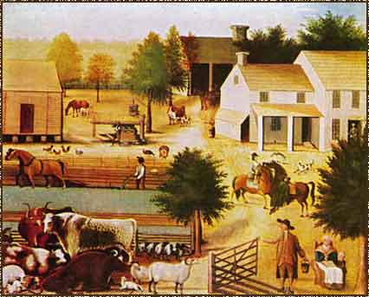
Colonization was important to Europeans because….
5. Colonies provides new places to live.

Slide 8
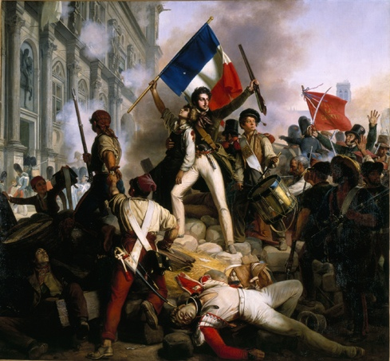
Colonization was important to Europeans because….
6. A wealthier country, has wealthier people, which makes them a happier people.
A happy country is unlikely to overthrow the government.
French Revolution

Slide 9
When we think of
Africa often think of
these things…

Slide 10
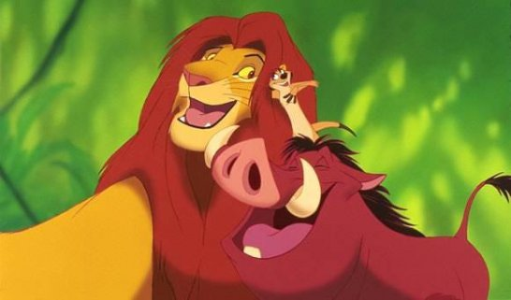
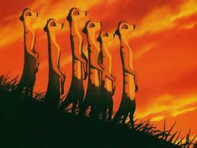
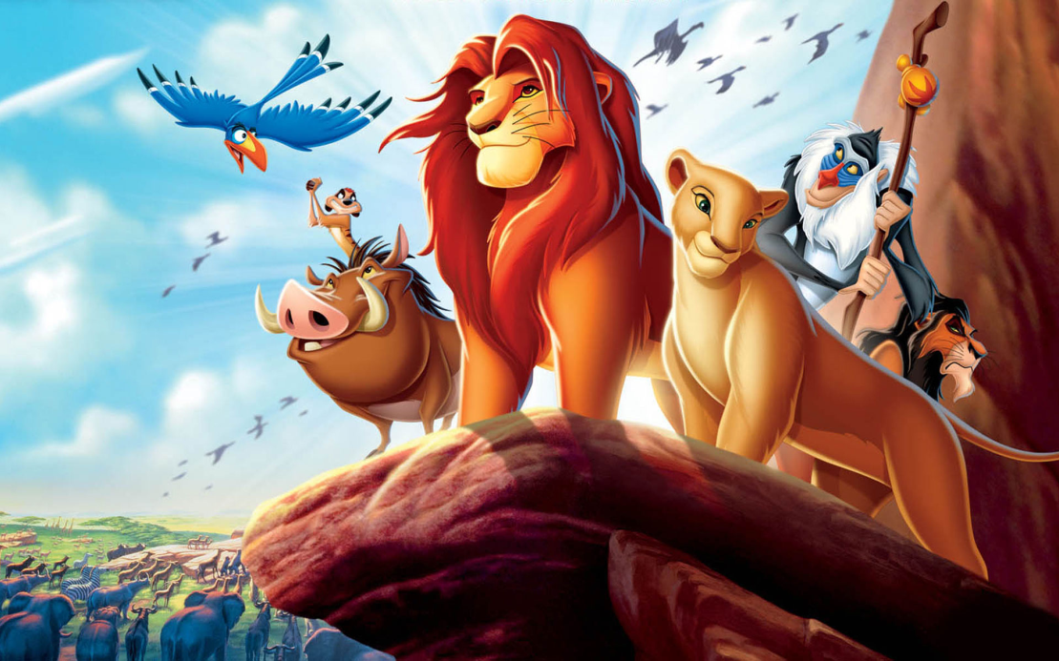
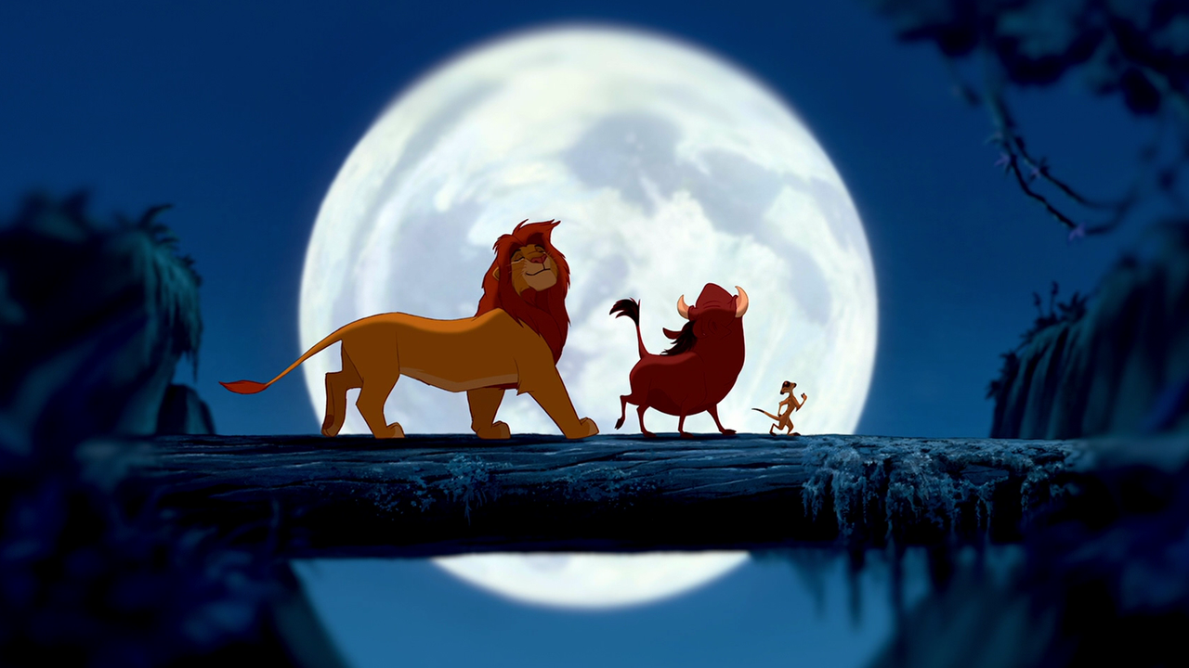
The Lion King

Slide 11
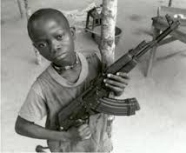
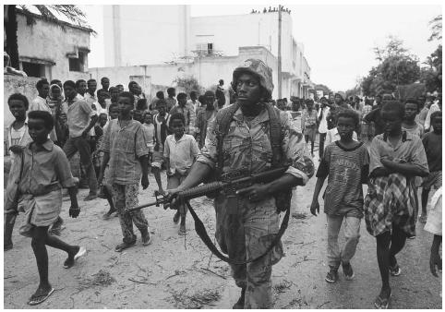
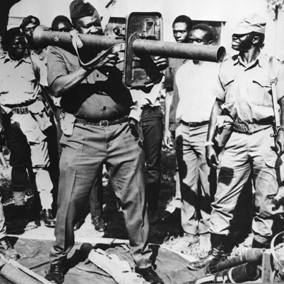
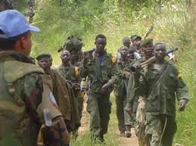
Civil War and Corrupt
Governments

Slide 12
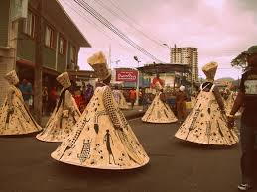
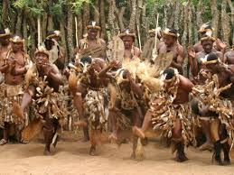
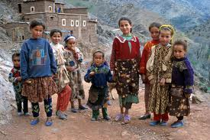
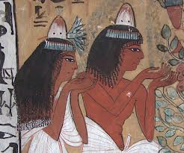
A variety of Different
Cultures and people

Slide 13
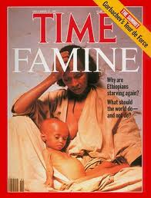
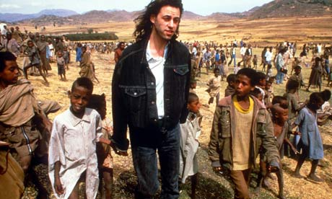
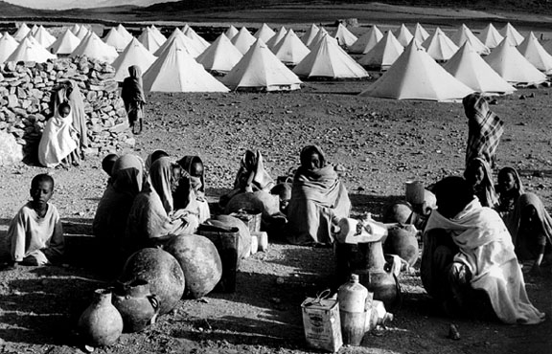
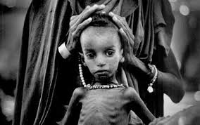
Famine and Disease

Slide 14
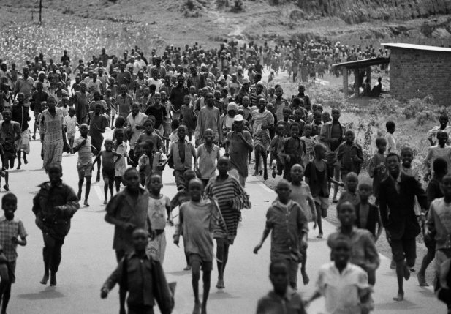
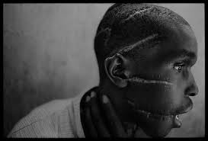
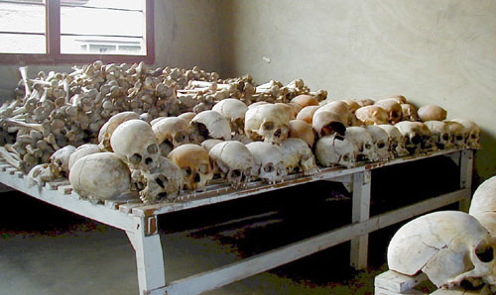
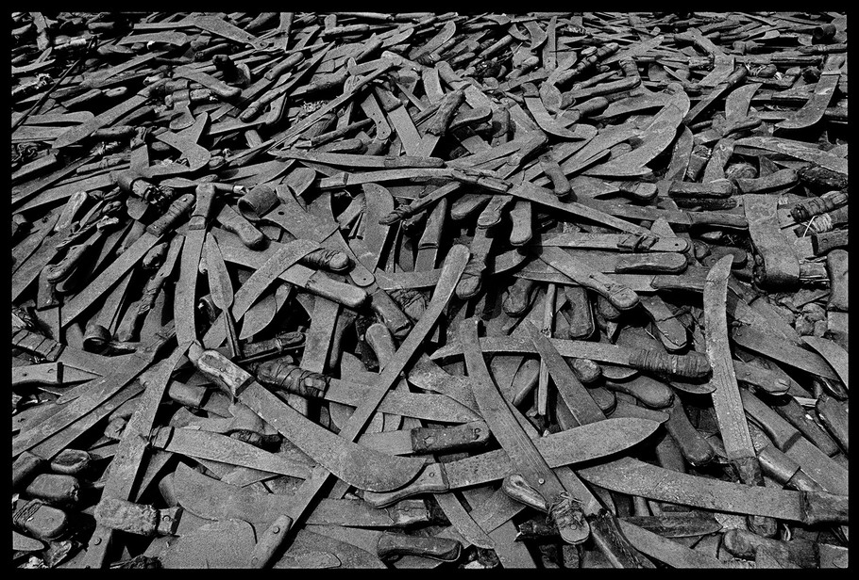
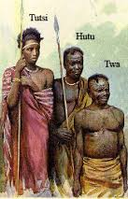
Genocide

Slide 15
Some of the problems in Africa
today are connected through
the time period known as
‘THE SCRAMBLE FOR AFRICA’.

Slide 16
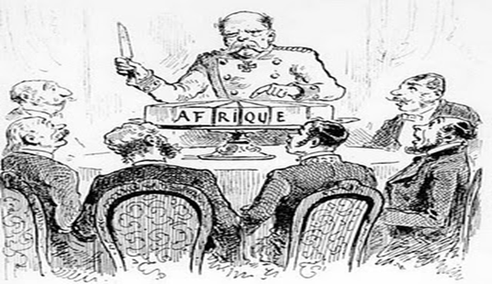
What is the Scramble for Africa
The Scramble for Africa is the rapid colonisation of Africa by European powers.
In simple terms, Europeans went to Africa and said this land belongs to my country now.

Slide 17
What is the Scramble for Africa
Countries wanted control over the Suez Canal (in between Asia and Africa) to have a faster way to India and China in Asia.

Slide 18
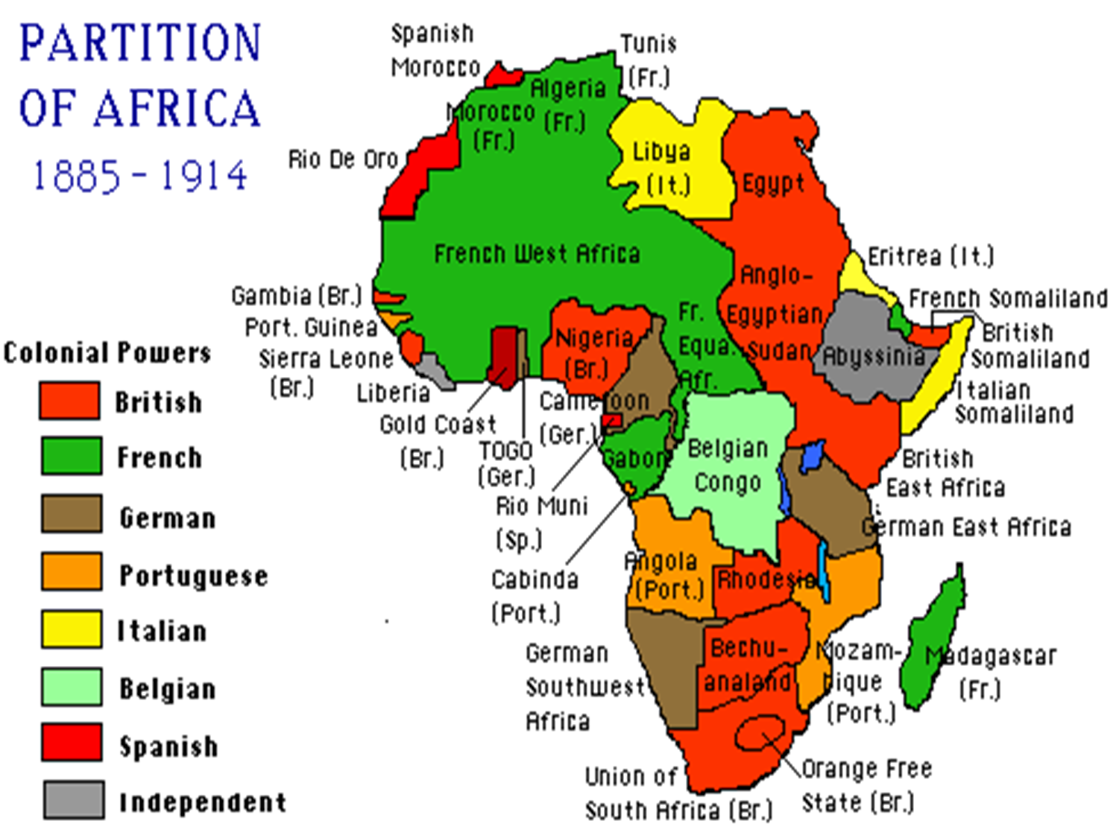

Slide 19
What is the Scramble for Africa
The Scramble for Africa happened between
1885-1914.

Slide 20
What is the Scramble for Africa
The Berlin Conference was held by European Countries to “fairly” divide up Africa.

Slide 21
What were some of the effects of the Scramble for Africa?
https://www.youtube.com/watch?v=0dXpAVE3frk

Slide 22
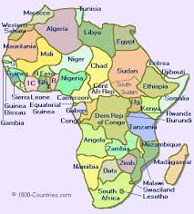
What were some of the effects of the Scramble for Africa?
Africa Today

Slide 23
What were some of the effects of the Scramble for Africa?
Europeans treated Africans very poorly.

Slide 24
What were some of the effects of the Scramble for Africa?
Europeans drew borders in Africa without caring about the different people groups of Africans already living there.
This caused lots of tension and violence among Africans living in the countries.

Slide 25
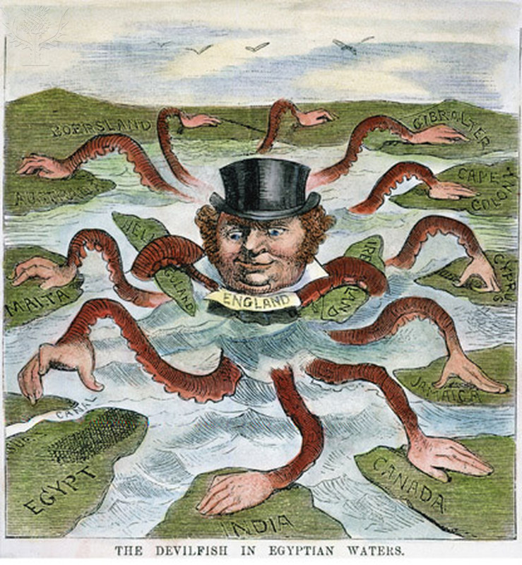
What do you think this political cartoon shows?

Slide 26
